Slide 1
Sequential Models, Attention and Transformers

Slide 2
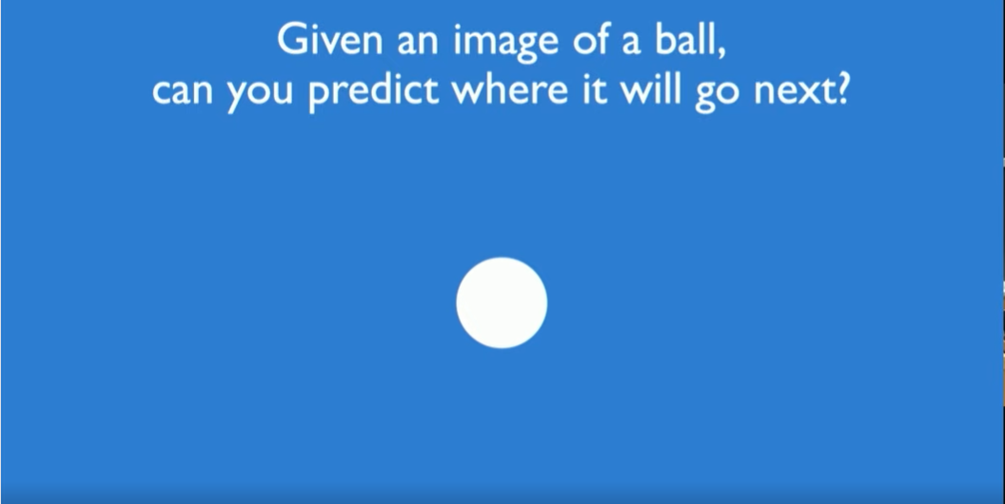

Slide 3
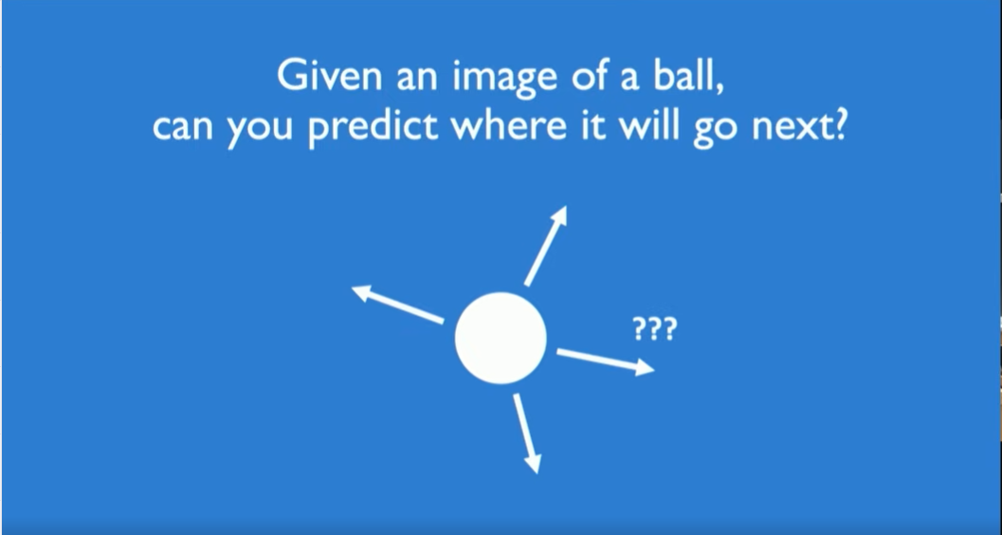

Slide 4
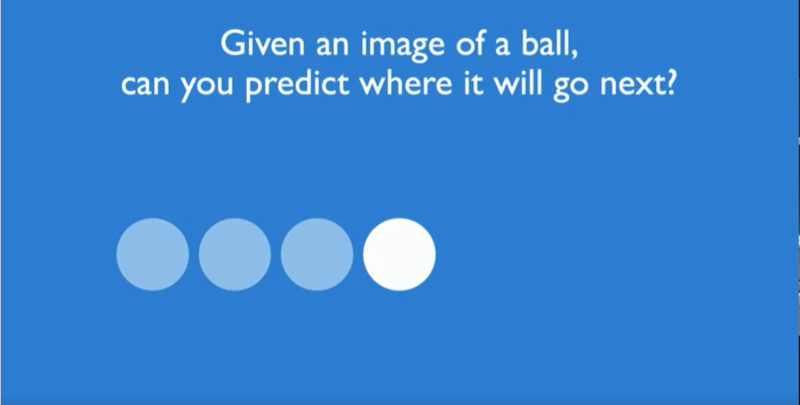

Slide 5
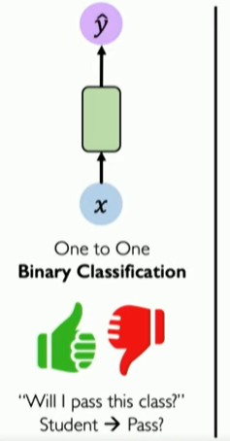
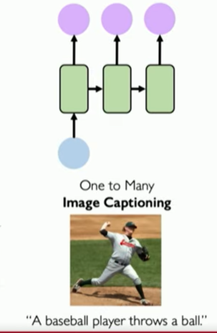
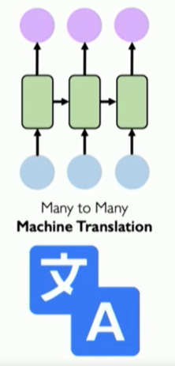
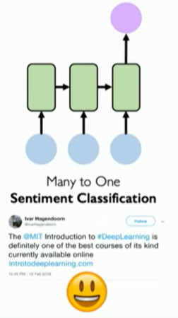
Sequence Modelling Applications

Slide 6
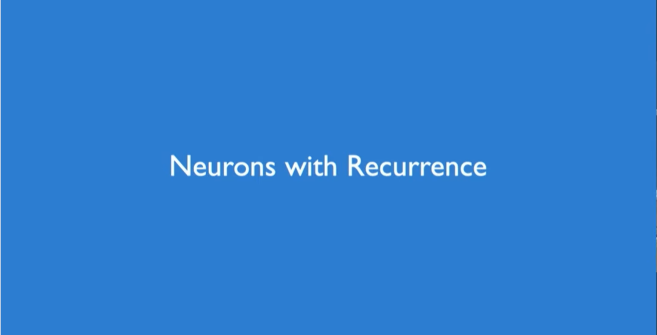

Slide 7
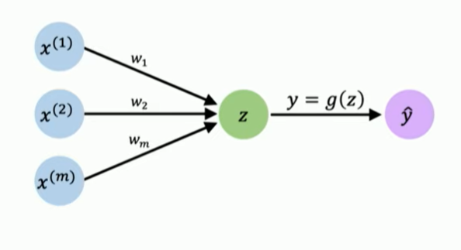
Perceptron

Slide 8
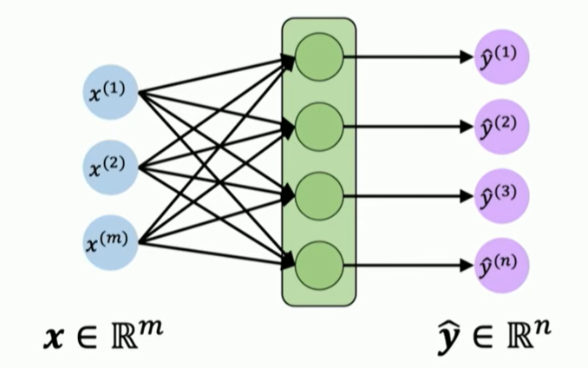
Feed Forward Neural Network

Slide 9
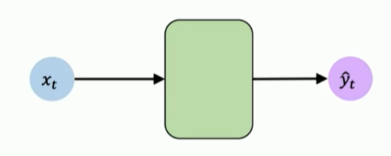
Feed Forward Neural Network

Slide 10
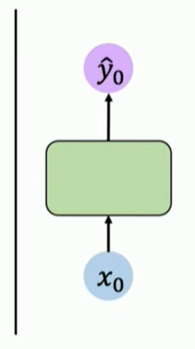
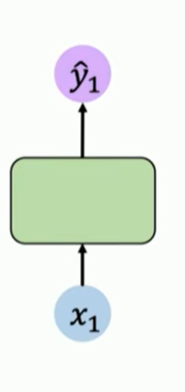
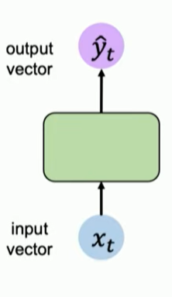
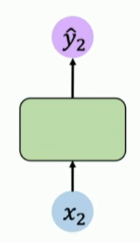

Handling individual Time Steps
Notes:
T used to denote a single time step

Slide 11
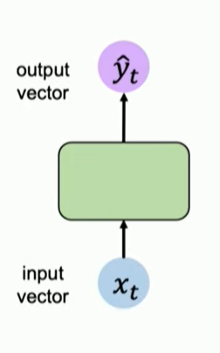
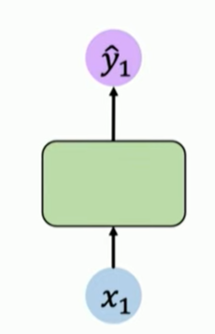
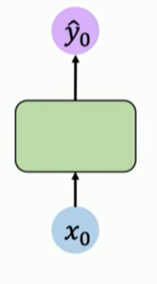
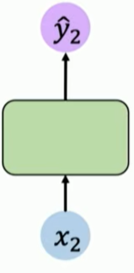



Neurons with Recurrence

Slide 12
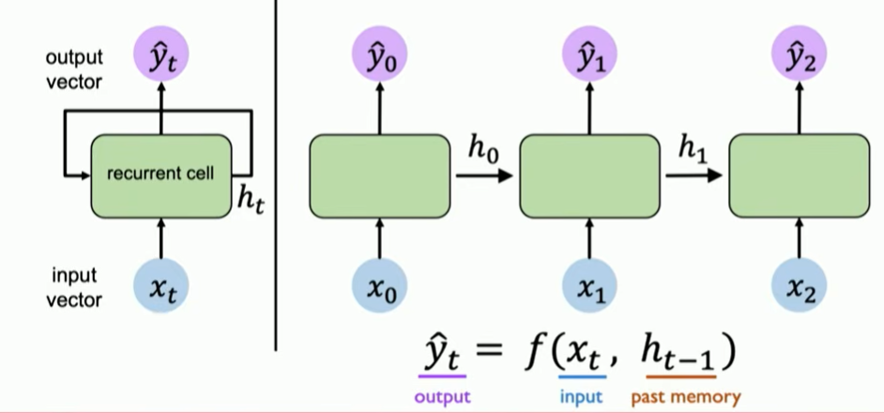
Neurons with Recurrence

Slide 13
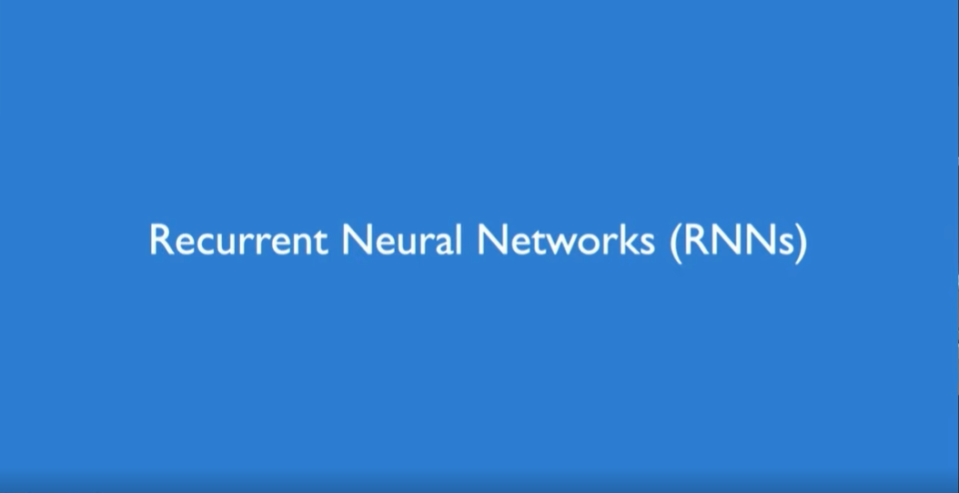

Slide 14
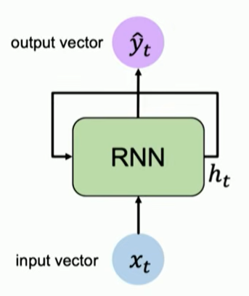

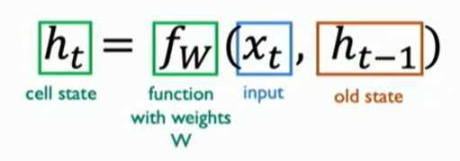

Recurrent Neural Networks (RNNs)

Slide 15
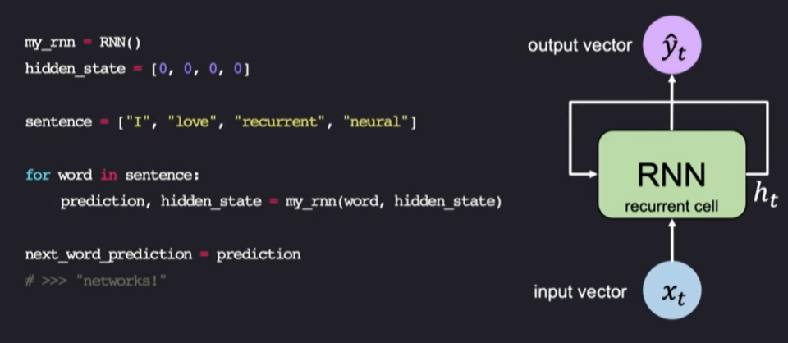
RNN Intuition

Slide 16
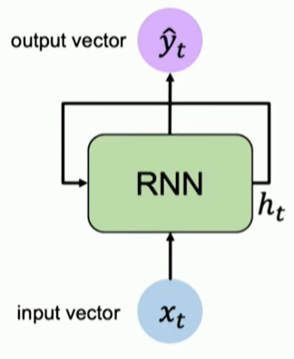
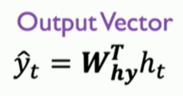
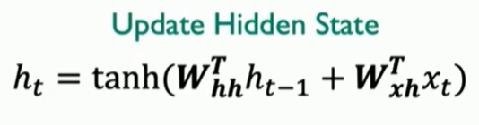
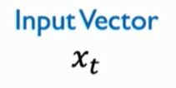
RNN State Update and Output

Slide 17
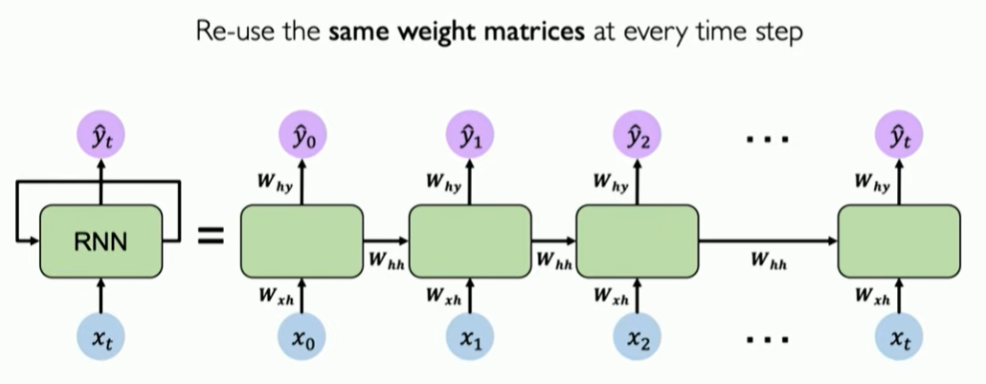
RNNs: Computational Graph Across Time

Slide 18
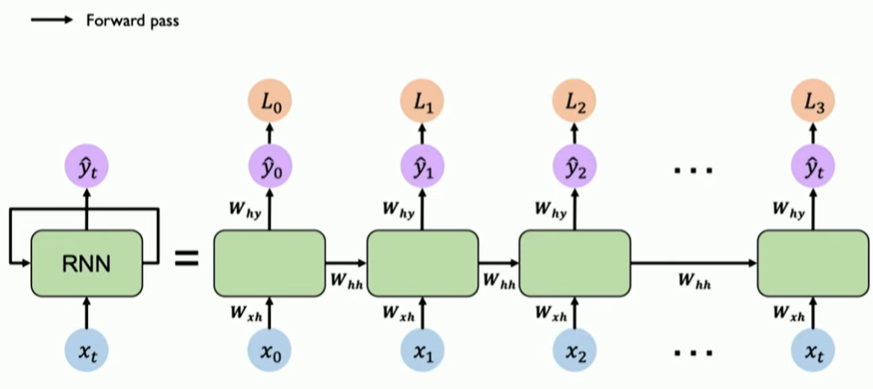
RNNs: Computational Graph Across Time

Slide 19
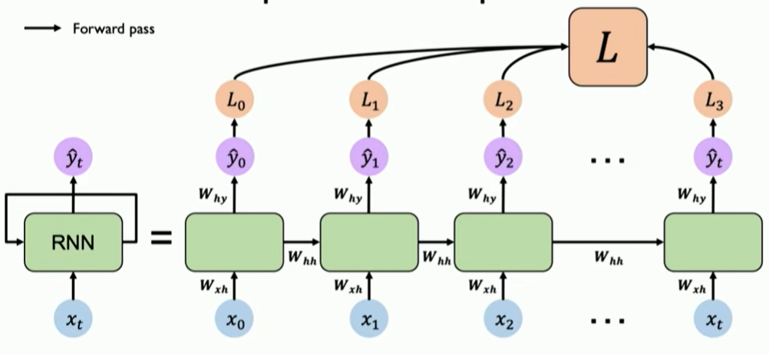
RNNs: Computational Graph Across Time

Slide 20
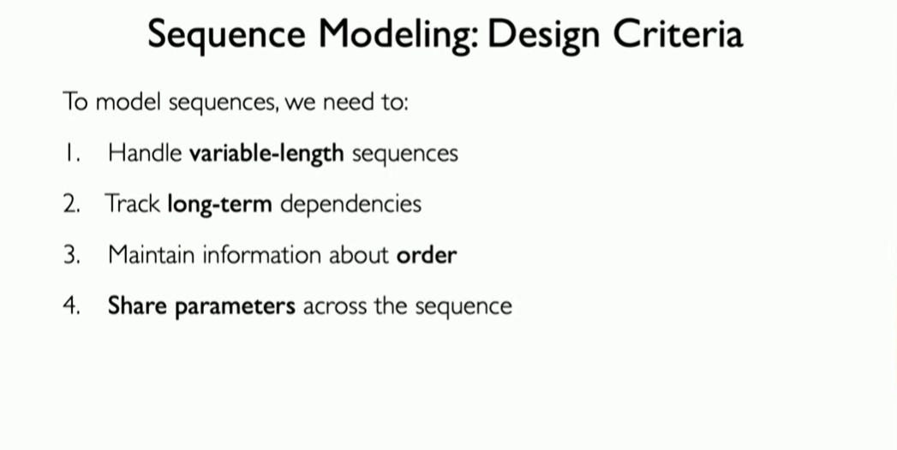

Slide 21
Types Of Recurrent Neural Networks
There are four types of RNNs based on the number of inputs and outputs in the network:
One-to-One RNN - This is the simplest type of neural network architecture where there is a single input and a single output.
One-to-Many RNN - The network processes a single input to produce multiple outputs over time. E.g image captioning
Many-to-One RNN - receives a sequence of inputs and generates a single output. E.g sentiment analysis the model receives a sequence of words
Many-to-Many RNN - processes a sequence of inputs and generates a sequence of outputs. language translation

Slide 22
Limitations of Recurrent Neural Networks (RNNs)
While RNNs excel at handling sequential data they face two main training challenges:
Vanishing Gradient: During backpropagation gradients diminish as they pass through each time step leading to minimal weight updates. This limits the RNN’s ability to learn long-term dependencies which is crucial for tasks like language translation.
Exploding Gradient: Sometimes gradients grow uncontrollably causing excessively large weight updates that de-stabilize training.

Slide 23
Variants of Recurrent Neural Networks (RNNs)
Vanilla RNN
This simplest form of RNN consists of a single hidden layer where weights are shared across time steps.
Vanilla RNNs are suitable for learning short-term dependencies but are limited by the vanishing gradient problem, which hampers long-sequence learning.

Slide 24
Introduction to LSTM
LSTM is a special type of Recurrent Neural Network (RNN) designed to capture long-term dependencies in sequential data while avoiding the vanishing gradient problem.
The problem with RNN is that they simply store the previous data in their “short-term memory”. Once the memory in it runs out, it simply deletes the longest retained information and replaces it with new data.
LSTM model attempts to escape this problem by retaining selected information in long-term memory. This long-term memory is stored in the so-called Cell State.
In addition, there is also the hidden state, in which short-term information from the previous calculation steps is stored. The hidden state is the short-term memory of the model.

Slide 25
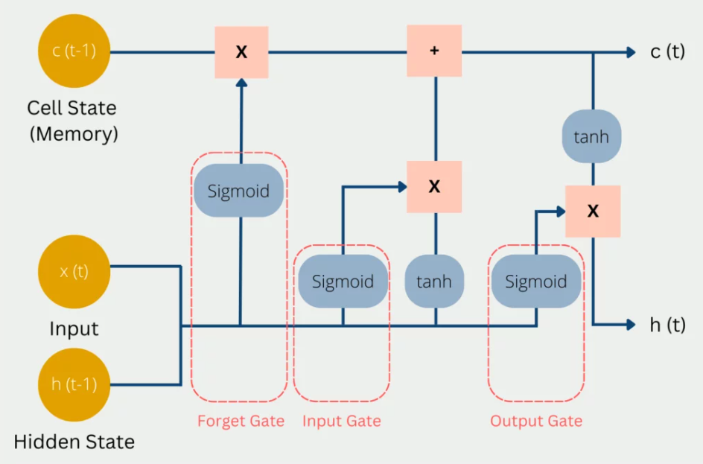
Structure of LSTM
In each computational step, the current input x(t) is used, the previous state of short-term memory c(t-1), and the previous state of hidden state h(t-1).

Slide 26
Long Short-Term Memory Networks (LSTMs)
Forget Gate: decided which current and previous information is kept and which is thrown out. This includes the hidden status from the previous pass and the current input. These values are passed into a sigmoid function, which can only output values between 0 and 1. 0 means that previous information can be forgotten
Input Gate: decided how valuable the current input is to solve the task. For this, the current input is multiplied by the hidden state and the weight matrix of the last run. All information that appears important in the Input Gate is then added to the Cell State and forms the new Cell State c(t).
Output Gate: output of the LSTM model is then calculated in the Hidden State. Depending on the application, it can be, for example, a word that complements the meaning of the sentence.

Slide 27
Gated Recurrent Units (GRUs)
Gated Recurrent Units (GRUs) simplify LSTMs by combining the input and forget gates into a single update gate and streamlining the output mechanism.
The architecture of LSTM is a bit complex and is computationally expensive. More time is required for training an LSTM. To deal with this, GRU was introduced which has relatively simpler architecture and was less computationally expensive.

Slide 28
LSTM vs GRU
LSTM consists of 3 gates whereas GRU consists of 2 gates.
LSTM has 2 separate states hidden state (Short term memory) and cell state (long term memory or internal memory) while GRU only has 1 state which is hidden state.
LSTM generally has more parameters compared to GRU.
It has been observed that LSTM performs slightly better in complex tasks. GRU performs comparable to LSTMs when data is limited or tasks are simpler.
A basic GRU block has 2 input and 1 output while LSTM has 3 input and 2 output

Slide 29
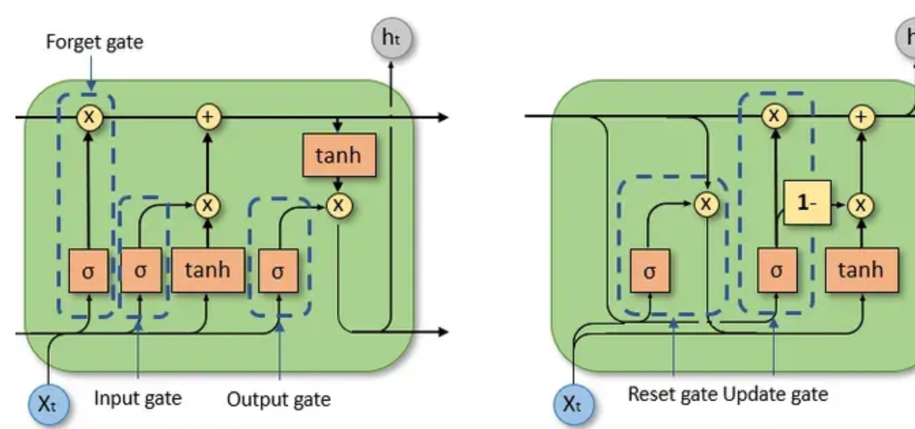
LSTM vs GRU

Slide 30
GRU Architecture
It merges the cell state and hidden state into a single hidden state and uses only two gates instead of three.
Update Gate - Controls how much of the previous hidden state should be carried forward to the next step. 1 - keep most of the old memory. 0 - focus on the new candidate.
Reset Gate - Decides how much of the past information to forget when calculating the candidate hidden state.
Candidate Hidden State - Combines the reset gate with the previous hidden state to create a new candidate:
New Hidden State - The update gate blends the old hidden state with the candidate:

